Slide 1
Query by Humming Searching Oct 28th
Jiarui Xu(Jerry), Alexander Lerch

Slide 2
This week
Test system on bigger database(200)
Search for ways to modify the accuracy and the calculation speed

Slide 3
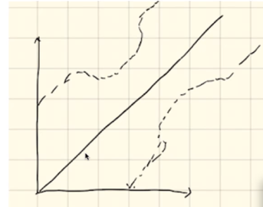
The results on 200files’ database
For 40 seconds’ piece.
Only use LB_Kim
accuracy: 12.5%
Use LB_Kim first, and top 5 rank(top 2.5%), use DTW(modified)
Accuracy: 9%
Use LB_Kim first, and top 10 rank(top 5%), use DTW(modified)
Accuracy: 11%
Use LB_Kim first, and top 20 rank(top 10%), use DTW(modified)
Accuracy: 11.5%

Slide 4
Searching for ways to modify
1. N. Mostafa et al. “A machine learning based music retrieval and recommendation system,” Proc. 2016 Tenth Int. Conf. on Lang. Res. Eval. (LREC), pp. 1970-1977, May. 2016.
proposes a Deep Neural Network (DNN) based note-transcription method to train the neural network using hummed notes which are considered as features.
2. J.-Q. Sun, S.-P. Lee, “Query by singing/humming system based on deep learning,” Int. J. Appl. Eng. Res. 12(13), pp. 973–4562 (2017).
Compare DL and DTW: J.-Q. Sun. used a similar approach to train a DNN for a Query by Singing/Humming system (QBSH).(problem: find massive data)

Slide 5
Searching for ways to modify
3. A. Ghias, J. Logan, and D. Chamberlin. “Query By Humming,” in Proc. ACM Multimedia 95, pp. 231-236, November 1995.
Ghias et al created a QBH system using the contour approach.(three possible relationships between pitches (‘U’, ‘S’ and ‘D’) , string matching to do that)(Problem: the time taken to retrieve the song was increased.)
4. Y. Zhu and D. Shasha, “Warping indexes with envelope transforms for query by humming,” in Proc. of the 2003 ACM SIGMOD Int. Conf. on Mgmt. of Data, New York, 2003.
Y. Zhu et al. applied DTW and compared the performance between the contour approach and time-series approach. (all the melody converted to a musical contour database.)(Problem: it is viable for a small database to get accurate results. However, this creates a challenge for a large music database.)
5. ‘SoundHound’ Group: use ML to first train the neural network on the hummed songs and then retrieve the song(Problem: it usually fails in most attempts to retrieve the correct song, due to noise and similar parts of songs.)

Slide 6
Thank you!

